Slide 1
Build a Bridge and Get Over It
Team 45 Design Challenge 5

Slide 2
London Bridge is Falling Down...
But Ours Won’t Because We Have these Requirements
Parallelogram shape
Walkways should be 10 feet wide
Sides rise 5 feet above walkway
2.5 Factor of Safety against failure

Slide 3
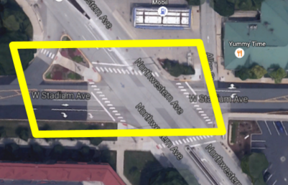
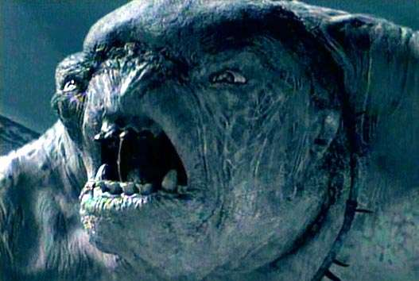
On the Corner of the Street where the Bridge Lives

Slide 4
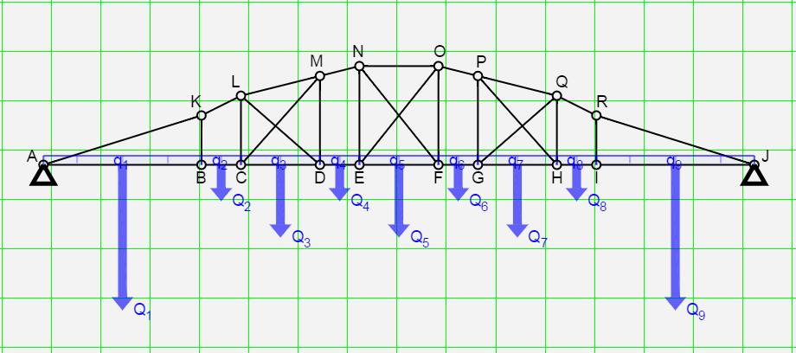
Draw Bridge -- Modeled after Engineering Fountain
“Let’s Put a Fountain in the Middle of the Street!” -- Josh Hahn, 4/18/2016, 1:45pm

Slide 5
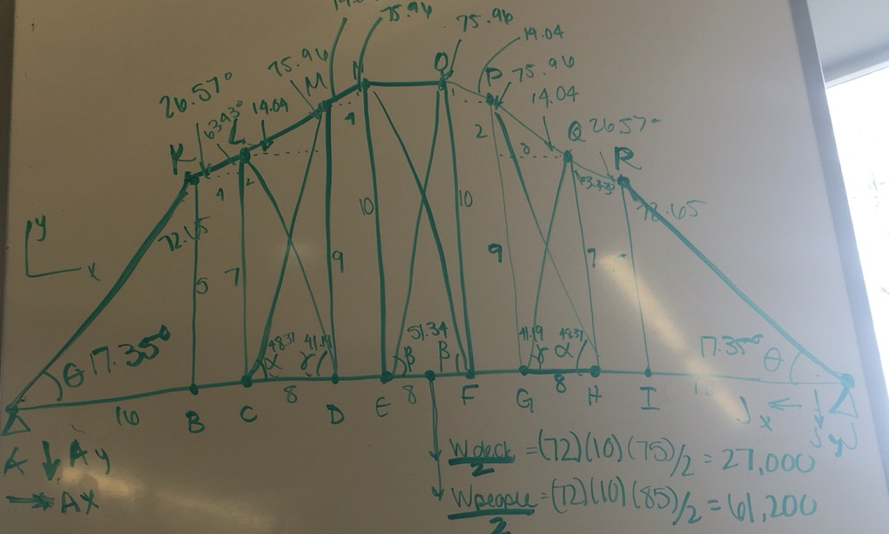
Free Body Diagram of Entire System --It’s Freeeeeee... NOT Free-Fallin’

Slide 6
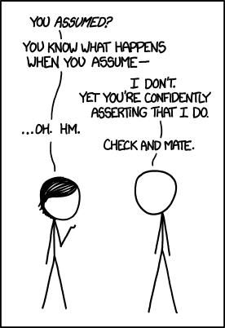
Assumptions
The cost and design of the deck should not be accounted for, but the deck weighs 75 lbf/ft²
Lateral and secondary bracing members do not need to be accounted for
All truss members are flat with rectangular cross sections
Weight of pedestrians modeled as uniform load with value of 85 lbf/ft²

Slide 7
You are the Weakest Link
Once weakest point was found, weight of bridge was taken into account, with cross-sectional area of 9 in²
This determined the materials of the bridge and the total cost
Point E/F (equal)
Max Forces: 8000 lbf

Slide 8
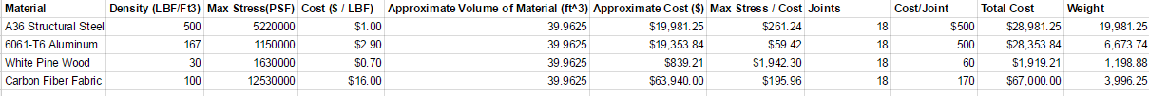
‘Cuz we are Living in a Material World
& it’s a Material ...Bridge

Slide 9
$7,676.84
Money, Money, Money... MONEY! The Total Cost of a White Pine Wood Bridge with 18 Nail Joints

Slide 10
Questions, Comments, Concerns, Snarky Remarks?
Thanks for Watching!
Team 45

